Slide 1
Neural Network Control Law

Slide 2
Introduction
In this project we are looking to implement a Neural network type control law. This doesn't mean there is something to be learned like in a normal NN problem Means the expression that describes the control signal U is mathematically equivalent to a NN
So we have a 2nd degree system (like a mass resort one) and we want to design a controller that will hopefully control our system in a much better way that a normal PID controller
Our guess is that the more measurements of the system our controller haves and the more complex is the control law, then the better the controller CAN be if tuned properly
Like for instance, a PID controller has 3 measurements (error, derivative of error and integral of error) and the way the control law is implemented is by making a linear combination of these 3. Resulting in 3 parameters or gains usually named Kp, Ki and Kd

Slide 3
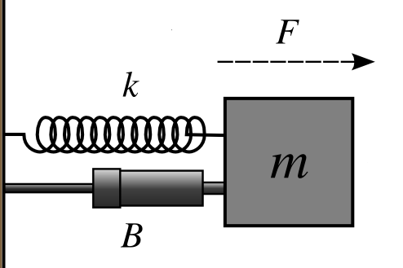
The system we are controlling
2nd degree system
Is our job to design a controller that recreate F such that the position of the mass is controlled on a desired value or set point (sp).(this sp is constant for the sake of simplification here)
This output is normally called U instead of F

Slide 4
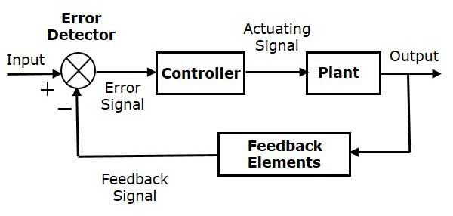

Slide 5
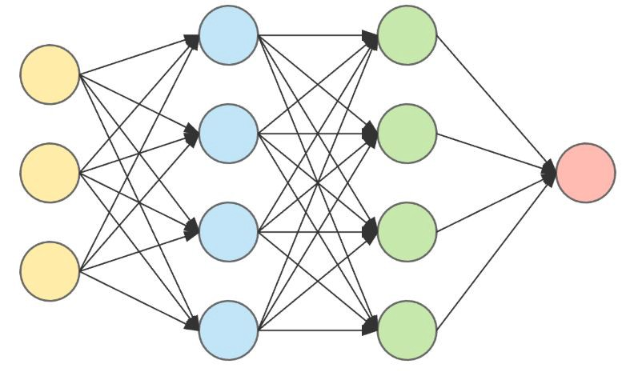
Description of the controller
The yellow input layers are the measurements of our system (position, velocity, acceleration. etc.) and some new features like the product between 2 inputs or polinomios.
And the red one is the output signal U witch is going to try to control our system

Slide 6
The problem here is that in a normal controller such as a PID we only need to find 3 values Kp, Ki, Kd to tune our controller
Here we have an entire NN to be tuned (find its weights and biases) (thousands of values maybe)
To do that we are going to make use of genetic algorithms

Slide 7

Genetic algorithm approach
So here the the genetic algorithm has to find the hole set of weights and biases of the NN law such that some fitness function J gets minimized
In this case $J=sum({ \left(x\left(t\right)−sp\right)}^{2} )$
This means that if J is little then the controller is doing its job correctly
So the genetic algorithm start with some random population of weights and biases, we run the simulation of our NN controller tryng to control our plant, we obtain x(t) and we calculate our fitness function J
The gentic algorithm uses that fitness function J to make its selection
It makes its cross over
Its makes its mutations
And it repeats the process

Slide 8
Results
Donne this way the algorithm had a hard time finding a good solution so what we did was to redefine our control law as follows
U=PID+NN_Law
Were the PID has already tuned parameters and we still wanna find the weight and biases of the NN
So in this way the controller already have like a base from where to start and we let the NN correct or improve the signal U

Slide 9
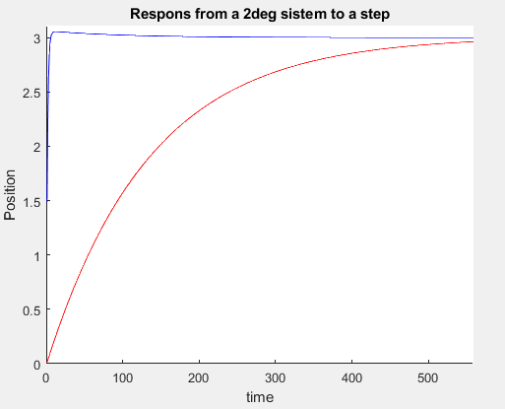
Results
Tunned PID response in red
Tunned PID + tunned NN response in blue

